Slide 1
HSNO Reforms - Highlights Package
Responsible Care Workshop
16 November 2017
Tania van Maanen

Slide 2
Outline
EPA – who we are and what we do
HSNO / HSW Split
EPA responsibilities after 1 December 2017
Key changes to HSNO Act
EPA Notices
Impact of new regime on approvals

Slide 3
Environmental Protection Authority
Government Agency est 1 July 2011
A standalone Crown entity
Report to the Minister for the Environment
Regulate activities that may potentially harm people or the environment
We have powers, functions and duties under various environmental Acts
www.epa.govt.nz

Slide 4
Legislative Reform of Workplace Health and Safety

Slide 5
Current HSNO
HS in workplaces
HS in non-workplaces
Risks to the environment
Risks to people
All lifecycle stages

Slide 6
Rules to protect workers from HS rules on the move
from
HSNO Act and Regulations
implemented by
to
HSW Act and Regulations
implemented by

Slide 7
Post 1 December 2017 – who does what
 | Rules on HS in workplaces to protect people (workers & public) | Rules on HS in workplaces to protect the environment and rules on disposal | Rules on HS at the top of the supply chain (importers & manufacturers) | Rules on HS in non-workplaces to protect people and the environment
Set under | HSW Act | HSNO Act | HSNO Act | HSNO Act
Regulator
Enforced by |  |  |  | Territorial Authorities

Slide 8
EPA responsibilities post 1 December 2017
Continue to approve new hazardous substances - all hazardous substances still need a HSNO approval
Reassessments
Develop EPA notices
New enforcement role
approvals
labels, SDS, packaging
product content controls

Slide 9
Key changes to HSNO Act
Test certification regime moved from HSNO to HSW Hazardous Substances Regulations
HSNO controls now in EPA Notices rather than regulations
Some changes to enforcement:
EPA given new enforcement role
WorkSafe only enforces HSNO environmental and disposal controls (in workplaces)
NZ police new enforcement role – retail fireworks

Slide 10
EPA Notices
Post 1 Dec 2017, most HSNO controls will be set in EPA Notices rather than regulations
Notices provide for consistency by consolidating rules currently spread across many different legal instruments
EPA Notices are issued by EPA Board
don’t need to go through Cabinet
can be updated quickly
robust process

Slide 11
EPA Notices that will be in force by 1 Dec 2017
In force now
Importers and Manufacturers Information
Enforcement Officer Qualifications
Issued - in force 1 December 2017
Minimum Degrees of Hazard
Classification
Labelling
Safety data sheets
Packaging
Disposal
Hazardous Property Controls
Forms and Information

Slide 12
Labelling Notice
Replaces labelling provisions in various HSNO Regulations and group standards
Adopts the provisions from the GHS 5th Edition
Alternative compliance provisions for certain overseas labelling (Australia, EU, USA and Canada), with some modifications
Correlation tables to convert GHS criteria to HSNO classifications
Includes transitional provisions

Slide 13
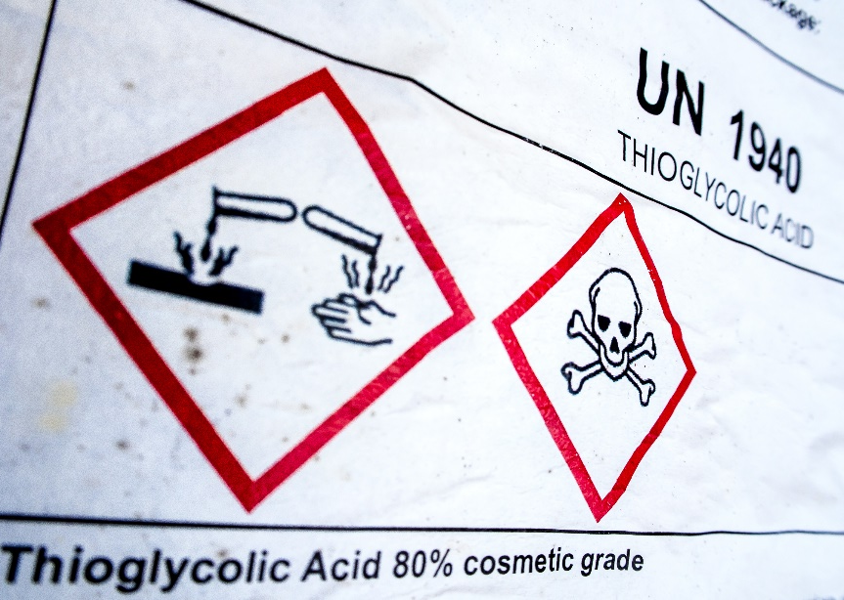
Labelling Notice (continued)
Duties on Importers and manufacturers (clause 7)
must ensure that the substance is correctly labelled as soon as practicable after importing or manufacturing the substance
Duties on Suppliers (clause 8)
must not supply the substance to another person if the substance is not correctly labelled

Slide 14
SDS Notice
Replaces SDS provisions in various HSNO Regulations and group standards
Adopts the provisions from the GHS 5th Edition
16 header SDS format
Alternative compliance provisions for certain overseas SDS (Australia, EU, USA and Canada), with some modifications
Correlation tables to convert GHS criteria into HSNO classifications

Slide 15
SDS Notice - Duties on Importers / Manufacturers (clause 5)
Importers and manufacturers of hazardous substances must:
obtain / prepare a HSNO-compliant SDS for every substance used in, or supplied to, a workplace
ensure SDS is correct, and review it every 5 years (except if substance not imported / manufactured in past 5 years)
also comply with duties on suppliers if relevant
New requirement regarding use of emergency contact number (clause 11)

Slide 16
SDS Notice – Duties on Suppliers (clause 6)
Suppliers of hazardous substances must:
provide the SDS when first supplying ANY quantity of a hazardous substance to a workplace (except certain consumer products)
If SDS amended, must supply amended SDS when next supplying substance
supply SDS upon request by any worker, emergency service worker, medical practitioner (except if supplier has not supplied the hazardous substance to any person in the past 5 years)
supply SDS if haven’t supplied that substance to a workplace for 5 years.

Slide 17
Packaging Notice
Replaces the packaging provisions in the Packaging Regulations and group standards
Aligns more closely with UN transport model regulations
New provisions for consumer goods
Alternative compliance provisions for some provisions, e.g. child resistant packaging.

Slide 18
Packaging Notice (continued)
Duties on Importers and manufacturers (clause 6)
must ensure that the substance is correctly packaged as soon as practicable after importing or manufacturing the substance
Duties on Suppliers (clause 7)
must not supply the substance to another person if the substance is not correctly packaged

Slide 19
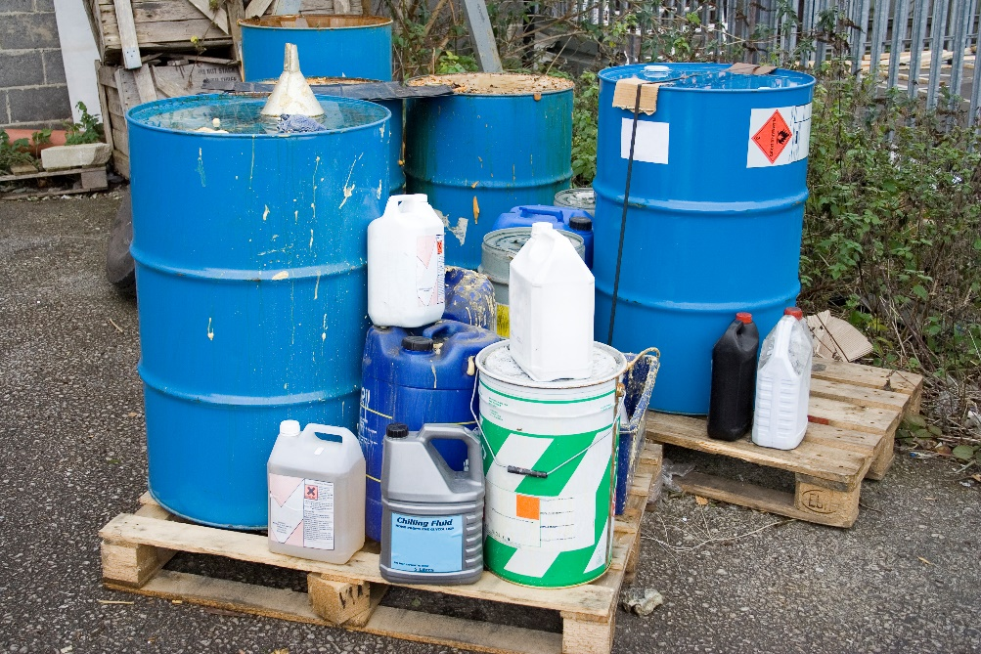
Disposal Notice
Replaces the disposal provisions in the Disposal Regulations and group standards
Deletes rules no longer needed
Updates some rules
Includes new rules
Transfers other rules unchanged

Slide 20
Hazardous Property Controls Notice
Sets controls on hazardous substances to:
protect the environment from ecotoxic substances (in both workplaces and non-workplaces)
protect people in non-workplaces e.g. homes

Slide 21
HPC Notice – controls to protect people in non-workplaces
Prohibit sale of highly hazardous substances (e.g 1080, most explosives) to non-workplaces unless permission from EPA issued
Controls on storage of HS in non-workplaces:
Below certain threshold quantities, need to comply with set of generic controls in HPC Notice
Above threshold quantities, need to comply with HSW HS Regulations, including obtaining any relevant compliance certificates

Slide 22
HPC Notice – controls to protect the environment
Protection of birds and bees
Spray drift of pesticides
Qualification requirements for users of highly ecotoxic pesticides
Generic workplace controls on storage, e.g. secondary containment, emergency response plans, signage

Slide 23
Group standards
New set of group standards re-issued for 1 December 2017
Re-issued group standards will:
refer to EPA Notices
include controls variations specific to that group standard where relevant
not include HSW controls

Slide 24
Group standards – transitional provisions
Re-issued group standards (including new substances)
MUST comply with the Labelling, SDS and Packaging Notices from 1 December 2021, but can comply earlier
Comply with Disposal Notice from 1 December 2017
Comply with HPC Notice from 1 December 2017

Slide 25
Existing individual approvals
No immediate plans to re-issue existing individual approvals (e.g. pesticides). Note this is not a reassessment.
Existing substances need to comply with existing controls until the approval is legally re-issued, except:
current HSNO workplace controls will no longer apply, need to comply with HSW Regulations immediately
need to comply with most of HPC Notice
Controls database on EPA website will display relevant HSNO controls and the HSW controls

Slide 26
New individual approvals (approved post 1 Dec 2017)
From applicant perspective essentially BAU
EPA will liaise with WorkSafe to ensure workplace risks adequately managed
EPA decision-making committee will approve or decline the substance based on outcome of risk assessment as usual
New Part 5 approvals will need to comply with the new EPA Notices immediately

Slide 27
Approvals and controls – current situation
Group Standards
Individual Approvals
HSNO Regulations
Transfer Notices
Control variations in approval
GS conditions

Slide 28
Approvals and controls – future situation
EPA Notices
Individual Approvals
Group Standards
variations
variations
HSW Hazardous Substances Regulations

Slide 29
When do I need to comply with the EPA Notices??
 | Substances covered by group standards | Individual approvals approved before 1 Dec 2017 | Individual approvals approved after 1 Dec 2017
Disposal Notice | 1 December 2017 | Immediately upon re-issue of approval | 1 December 2017
HPC Notice | 1 December 2017 | Some clauses 1 Dec 2017 Whole Notice upon re-issue of approval | 1 December 2017
Labelling Notice | 1 December 2021 (clause 36) | 2-4 yrs from date of re-issue of approval (clause 35) | 1 December 2017
SDS Notice | 1 December 2021 (clause 14) | 2-4 yrs from date of re-issue of approval (clause 13) | 1 December 2017
Packaging Notice | 1 December 2021 (clause 28) | 2-4 yrs from date of re-issue of approval (clause 29) | 1 December 2017

Slide 30
Summary of Agency Roles
EPA / HSNO Act | WorkSafe / HSW Act
Approves substances Issues group standards Carries out reassessments Sets controls to protect the environment Sets controls on importers and manufacturers at top of supply chain Sets controls on HS stored or used in non-workplaces Most controls set in EPA Notices Develops guidance Enforcement agency for some HSNO controls (e.g labelling, SDS, packaging) | Sets requirements on HS in workplaces to protect workers and others Requirements set in HSW Hazardous Substances Regulations and Safe Work Instruments Develops new SWI where required Develops guidance and codes of practice Enforcement agency for HSW HS Regulations and some HSNO controls (environmental and disposal)

Slide 31
Thanks for listening
Questions??

Slide 32
Further information
hsreform@epa.govt.nz

