Slide 1
Working Together on Health and Safety
Hazardous Substances Reforms
Last Updated: 1 September 2017
Notes:
Note to presenters
This presentation is an overview, providing the high level context for the Health and Safety at Work Act 2015 (HSWA), Hazardous Substances Reforms.
It takes a look at the reasons for the reforms, the regulatory changes and how people can keep informed.
It does not represent everything duty holders need to do to comply with the Regulations.
It was developed in July 2017 and may be updated in future.

Slide 2
OVERVIEW:
Introduction
1 Reasons for reform
2 Hazardous Substances
3 Key changes
4 How to keep informed

Slide 3
Introducing the Hazardous Substances Regulations
Next step in the Health and Safety at Work Act
Available on the Legislation website
Come into force on 1 December 2017
WorkSafe and EPA, along with MBIE and MfE, are collaborating to implement the reforms
Notes:
The Health and Safety at Work (Hazardous Substances) Regulations are the next step in the Health and Safety at Work Act (HSWA) and associated regulations.
HSWA sets out health and safety duties for everyone in the workplace. The Hazardous Substances Regulations establish controls for manufacturing, using, handling and storing hazardous substances in the workplace.
Both are available on the Legislation website (www.legislation.govt.nz).
The Hazardous Substances Regulations will come into force on 1 December 2017.

Slide 4
1
Reasons for reform

Slide 5
Reasons for the reforms
Independent Taskforce on Workplace Health and Safety
Complex legislation
Approximately 150,000 businesses use, handle, manufacture or store hazardous substances.
Key outcomes being sought:
Greater certainty and clarity
Improved work-related health outcomes
Better hazardous substances risk management
Notes:
Hazardous substances were identified by the Independent Task Force on Workplace Health and Safety (set up after the Pike River Mine explosion) as a key area of work-related health and safety that needs to improve.
The reforms aim to help reduce both immediate harm and longer term illness caused by work-related use of hazardous substances.
It will do this by simplifying the regulatory landscape for hazardous substances.
A lot of different sets of rules and exceptions are pulled together into one place.
It will make it simpler for many businesses to understand their obligations and comply with the law.
These Regulations will be relevant to about 150,000 business across New Zealand, encompassing a wide range of sectors and industries.

Slide 6
Every year:*
Many more unreported cases
30,000 new cases of serious ill-health
600 to 900 deaths
Many of these work-related diseases can be caused by exposure to hazardous substances.
* estimated figures
Notes:
Before we think about what’s changing it’s important to remember why.
Around 150,000 businesses in New Zealand use, handle or store hazardous substances.
Deaths from work-related health issues are 10 times higher than deaths from injuries. There are approximately 600 – 900 fatalities from work-related diseases annually; and another 30,000 suffer serious ill-health. Many of these diseases can be caused by exposure to hazardous substances.*
It is also estimated that 75% of businesses do not currently comply with the eight key controls (rules) for safely managing the risks of working with hazardous substances.**
*Work Related disease statistics are from a 2012 study called “Work Related Disease in New Zealand”, by MBIE which estimates the number of work-related disease deaths at 600-900 per year.
**Statistic of 75% of businesses not currently complying with the eight key controls when working with hazardous substances comes from the EPA survey of 400 businesses in 2012.

Slide 7
Key regulatory changes
Introducing: Health and Safety at Work (Hazardous Substances) Regulations
Changing: Hazardous Substances and New Organisms Act (HSNO)
Introducing: Safe Work Instruments (WorkSafe)
Introducing: EPA Notices
Regulation of hazardous substances that affect human health and safety in the workplace
Notes:
Remember that there is already legislation in place that duty holders should be complying with - the Hazardous Substances and New Organisms Act.
There are two main pieces of legislation that are affected by the reforms:
The Hazardous Substances and New Organisms Act 1996 (HSNO) and its regulations will change.
The Health and Safety at Work (Hazardous Substances) Regulations will be introduced.
The rules to protect people from workplace activities involving hazardous substances are moving from HSNO to HSWA and the Hazardous Substances Regulations.
Controls for hazardous substances outside workplaces, and those that affect the environment remain within HSNO.
There are also two types of subordinate legislation:
WorkSafe will develop Safe Work Instruments for approval by the Minister. These will have a number of uses including defining more detailed or technical matters or prescribing standards. Safe Work Instruments are discussed in more depth in another slide.
EPA Notices: most of the hazardous substance rules that the EPA remains responsible for will be set in EPA Notices rather than by regulation.
While the approach has been to move the rules for work-related use of hazardous substances from the HSNO framework to the HSWA regime, there will also be a number of additional requirements relating to the safe manufacture, use, handling and storage of hazardous substances.

Slide 8
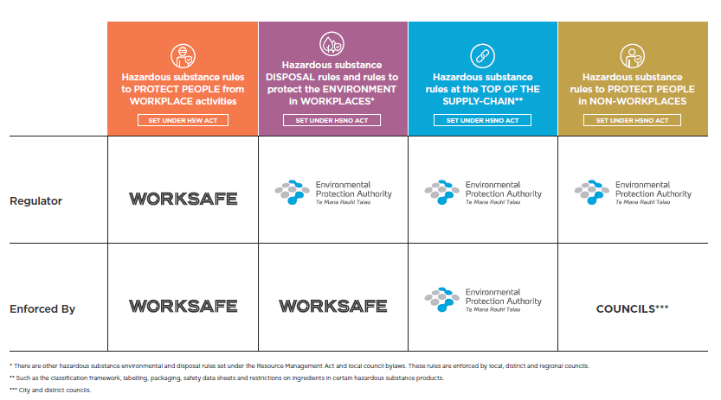
Roles of WorkSafe and the EPA
Notes:
Currently:
HSNO is largely implemented by the Environmental Protection Authority (EPA). The workplace requirements are currently enforced by WorkSafe.
HSWA is primarily regulated and enforced by WorkSafe.
In the new regime (this is a very broad overview):
The EPA will continue to be responsible for approvals, setting the rules for classification, labelling, safety data sheets (SDS), packaging and disposal as well as for protecting the environment and public health.
Under HSWA, WorkSafe will regulate the ‘downstream’ use, storage and handling of hazardous substances in workplaces. Under HSNO, WorkSafe will enforce the ecotoxic and disposal requirements in the workplace.
Which means:
For many impacted businesses, compliance related to hazardous substances will fall predominately under HSWA (particularly ‘downstream’ businesses that use, handle and store hazardous substances in the workplace).
Manufacturers and importers (for example) will need to deal with the EPA on some things (like gaining approval of substances, providing basic contact information to the EPA, SDSs and labelling); and with WorkSafe on workplace requirements.
(Note that the regulation of sales of retail fireworks: NZ Police)

Slide 9
Safe work instruments
Subordinate legislation introduced with HSWA
Only have legal effect if they are specifically referred to in Regulations.
Two types for Day 1:
replacing some HSNO Codes of Practice
continuing some workplace controls set in individual substance approvals made by EPA
A range of uses including:
prescribing technical matters
setting modified workplace requirements
providing alternative means of complying with regulations
Notes:
Safe Work Instruments are a type of subordinate legislation. They were introduced with the Health and Safety at Work Act.
SWIs are developed by WorkSafe and approved by the Minister.
They are notified in the Gazette.
They can be used for a wide range of purposes under HSWA but only have legal effect if they are specifically referred to in Regulations. Under the Hazardous Substances Regulations they will be used to:
Prescribe detailed or technical matters that change relatively frequently and will often be industry-specific
Set additional or modified workplace requirements for hazardous substances approved or reassessed by the Environmental Protection Authority (EPA)
Provide alternative means of complying with regulations
The first 13 safe work instruments will cover:
Polyethylene above ground stationary tanks for diesel fuel
Management of pre-2006 stationary container systems up to 60,000L
Filling of below ground petrol tanks by pumping
Design and construction of above ground stationary tanks to ULC/ORD-C80.1-2000
Action taken in relation to disused below ground tanks on farms
Markings for pipework connected to above ground stationary tanks
Reduced secondary containment for certain above ground stationary tanks
Specification of standard relating to non-fillable containers
Thermoplastic stationary tanks
Above ground stationary tanks connected to a generator set
Above ground rotationally-moulded polyethylene tanks
Additional and modified requirements for specified Class 6 and 8 substances
Modified requirements for specified fumigants

Slide 10
HSWA and the GRWM Regulations
Other relevant requirements under HSWA / General Risk and Workplace Management (GRWM) Regulations include:
Managing risks in accordance with the hierarchy of controls
Providing information, training and instruction
Providing workplace facilities, including ventilation and facilities to control airborne contaminants
Providing Personal Protective Equipment
Notes:
Remember to take into account other relevant requirements under the health and safety legislative framework such as the Act itself and the Health and Safety at Work (General Risk and Workplace Management) Regulations (GRWM). This includes duties to:
Manage risks associated with the hierarchy of controls (GRWM regs 5 – 8 and 28)
Provide information, training and instruction (GRWM reg 9)
Provide workplace facilities (GRWM regs 10 – 11) including ventilation and facilities to control airborne contaminants
Provide PPE (GRWM Reg 15)

Slide 11
2
Hazardous substances

Slide 12
Hazardous substances
Hazardous substances can be extremely dangerous.
Used safely they contribute to New Zealand’s economic growth and prosperity.
Used incorrectly they can cause catastrophic accidents, such as fires and explosions, and serious harm to people who are exposed to them.
Common hazardous substances can be taken for granted.
A lack of understanding can lead to serious consequences.
Notes:
As the name suggests, by their very nature hazardous substances can be extremely dangerous.
Used safely they contribute to New Zealand’s economic growth and prosperity.
Used incorrectly they can cause catastrophic accidents, such as fires and explosions, and serious harm to people who are exposed to them.
Serious accidents involving these hazardous substances do happen, but it’s important to also be aware of the less obvious harm caused by exposure to hazardous substances at work. This harm results from people being exposed to hazardous substances in three main ways:
Breathing them in - liquid hazardous substances can often also give off hazardous vapours into the air you breathe. You may not know the vapours are there as they often have no smell.
Through the skin - hazardous substances can go through your skin and get into your blood. Once in your blood they cause damage as the blood moves around your body.
Swallowing them - hazardous substances can be swallowed if, for example, you eat or smoke without washing your hands after using them.
A lack of understanding about the harm that can occur from exposure is a serious problem with serious consequences.
A hazardous substance may be a single hazardous chemical or a mixture of both hazardous and non-hazardous chemicals. Most products used in the workplace are a mixture of chemicals.
Common hazardous substances at work can be taken for granted, for example commercial cleaning products, paints, adhesives, acids, bases and solvents.
A hazardous substance has one or more of the following properties (above specified levels):
Explosive
Flammable
Able to oxidise (ie accelerate a fire)
Corrosive
Toxic (to humans)
Ecotoxic (ie can kill living things either directly or by building up in the environment)
Able to generate a hazardous substance on contact with air or water.

Slide 13
Hazardous substance classifications
The hazardous properties of a substance are classified to determine how the risks can be managed. There are eight key classes:
Each class, or group of classes, has specific rules under the Regulations.
Notes:
The Regulations refer a lot to hazardous substance classifications. The hazardous properties of a substance are classified to determine how the risks can be managed. There are eight key classes:
Class 1 – explosives
Class 2 – flammable gases
Class 3 – flammable liquids
Class 4 – flammable solids
Class 5 – oxidising substances
Class 6 – substances toxic to people
Class 8 – corrosive substances
Class 9 – substances that are toxic to the environment (these are not dealt with by the Hazardous Substances Regulations. They will continue to be regulated by the Environmental Protection Authority (EPA).
Class 7 is missing from this table. This covers radioactive materials and is not regulated under HSNO or HSWA. (Radioactive materials are regulated under the Radiation Safety Act 2016)
Each class, or group of classes has specific rules.

Slide 14
Risk management
Proactively manage the risks that come from having hazardous substances in your workplace.
First consider whether you really need the substance – can you eliminate it, or substitute it for a safer one?
If a hazardous substance has to be in your workplace, put in place the specific controls required to manage it.
If any risk remains, manage it using the hierarchy of controls
Notes:
1. Consider whether you need a hazardous substance in your workplace or can eliminate or substitute it with a safer one.
2. Put in place the technical controls from the Hazardous Substances Regulations.
3. ASSESS your workplace and IDENTIFY if any risks remain that you need to manage
4. Use the hierarchy of controls under HSWA (GRWM Regulations 6) to determine the most effective control measures to MINIMISE those risks (see the next slide on the hierarchy of controls)
5. MONITOR the performance of the control measures
6. MAINTAIN and REVIEW the control measures.

Slide 15
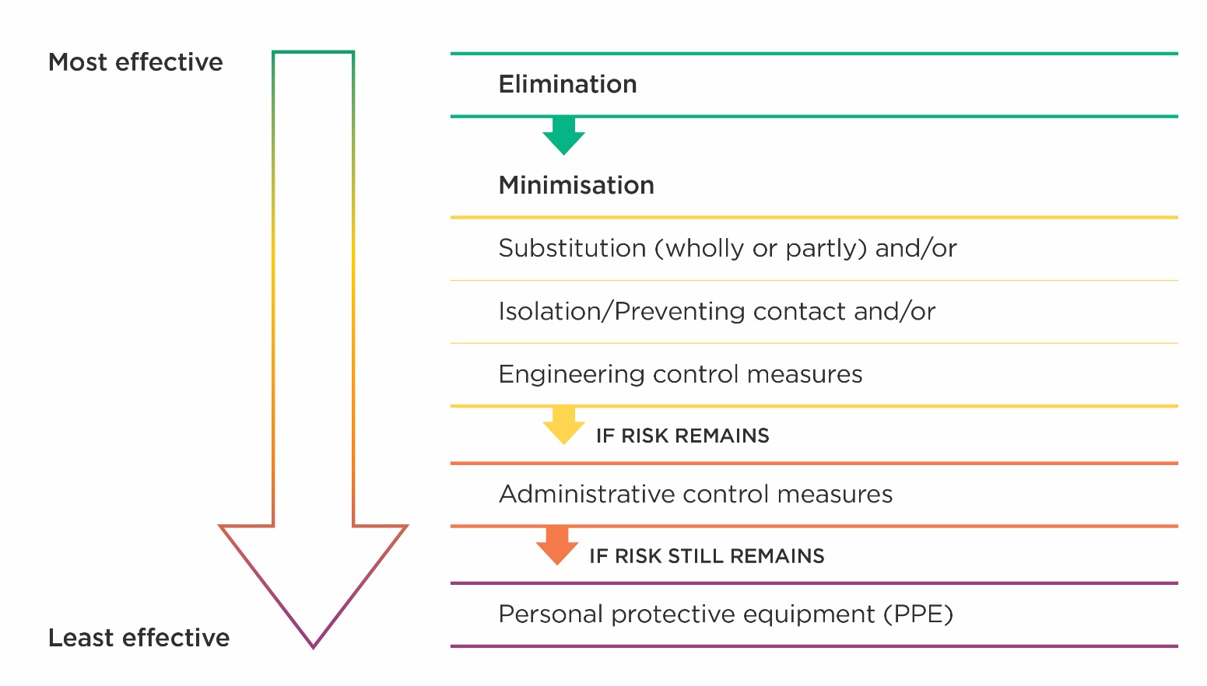
Hierarchy of control measures
Notes:
The hierarchy of controls is set out in the GRWM Regulations. Essentially, it means working through the following measures until the risk to workers from hazardous substances can be removed or minimised.
ELIMINATION
Can the hazardous substance be removed from the workplace?
MINIMISATION
If elimination is not possible consider (in this order):
Substitution: Whether the substance could be replaced by one posing less risk, such as substituting solvent based inks with inks made from vegetable oil.
Isolation: Isolating the hazard can prevent people coming into contact with it, for example spray painting in a fully automated booth.
Engineering control measures: Apply physical control measures to minimise risk, such as ventilation.
Administrative controls: If engineering controls are not sufficient to remove the risk, you are required to apply processes to make your workplace safer, e.g. job rotation to reduce the time someone is exposed to a hazardous substance.
Personal protective equipment (PPE): If the risk remains after all other measures have been applied, you must supply and ensure the use of personal protective equipment. For example, respirators can protect staff from inhaling hazardous substances.

Slide 16
3
Key changes
Notes:
Some key requirements around the safe management of hazardous substances apply to all PCBUs that use hazardous substances. This presentation looks at some of these requirements.

Slide 17
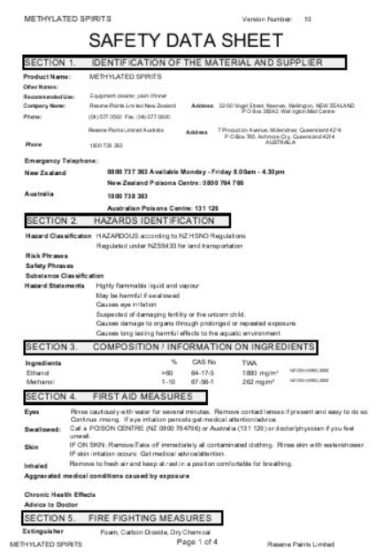
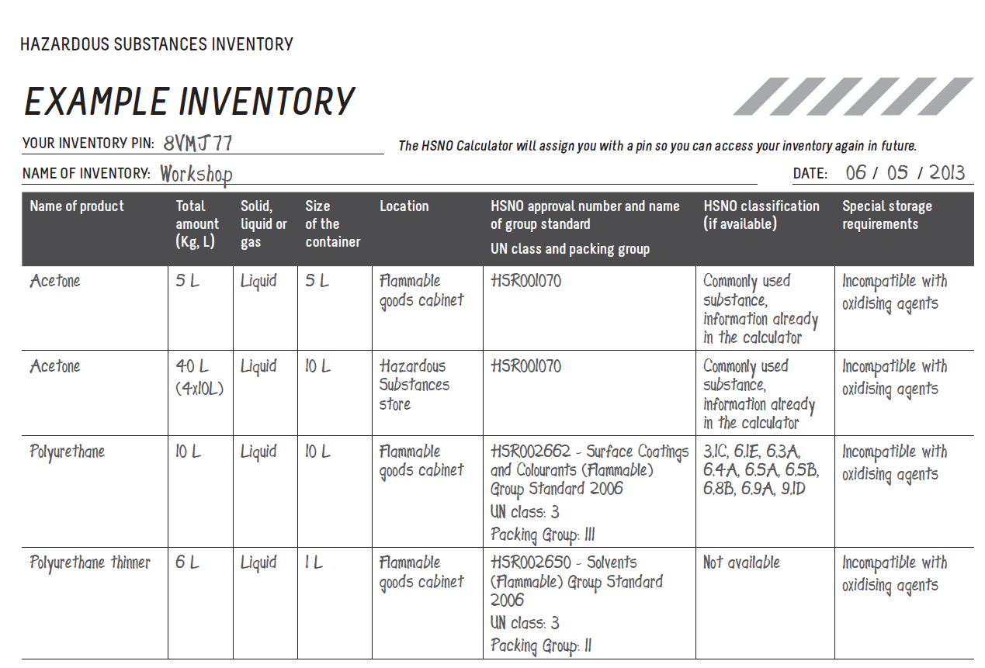
Key changes
Safety Data Sheets
Inventory
Information, instruction, supervision and training
Emergency Response Plans
Labelling
Signs
Notes:
Safety Data Sheets
PCBUs must have a safety data sheet (SDS) for each hazardous substance they hold.
Suppliers of hazardous substances to a workplace must provide a compliant SDS with their product.
WorkSafe regulates the ‘purchasing’ PCBU in its duties to have a current SDS; while the EPA regulates the suppliers in their duty to supply the SDS.
Inventory
All PCBUs must prepare an inventory recording all hazardous substances they have at the workplace. It must include information on:
The substance’s name and UN number (if available)
The maximum amount likely to be at the workplace
Its location
Any specific storage and segregation requirements.
For each hazardous substance listed in the inventory, the current safety data sheet or a condensed version of the key information
Any hazardous waste
Information, instruction, supervision and training
General instruction, supervision and training requirements provisions are given in the Health and Safety at Work (General Risk and Workplace Management) Regulations (GRWM). The Hazardous Substances Regulations provide more specific requirements to ensure workers who use, handle, manufacture or store hazardous substances have adequate information, training and instruction. This includes:
Workers need information about: any work involving hazardous substances in their work area; and where to find information (including safety data sheets) about the hazards and how to safely handle and store the substances found in their workplace.
PCBUs must provide workers with instruction and training including on: the hazards associated with the substances they handle at work; how to safely handle, use, manufacture, store and dispose of the substances; safe use of plant and equipment – including Personal Protective Equipment (PPE); and what to do in an emergency. Workers must get supervised experience in these matters even if they received training and instruction at another workplace.
PCBUs must keep a record of this instruction and training.
Emergency Response Plans
Businesses that deal with certain substances and quantities must prepare, implement and maintain an emergency response plan (ERP). Mostly the requirements stay the same but there are some changes such as the plans:
Addressing all ‘reasonably foreseeable’ rather than ‘reasonably likely’ emergencies
Stating any special training needed (by those who have responsibilities in the ERP) to deal with an emergency involving each substance
Including the inventory of hazardous substances present at the workplace.
Including a site plan showing all the hazardous substances locations in the workplace.
There is also a new provision that Fire and Emergency New Zealand (FENZ) can review your plan (at your request or at FENZ’s initiative) to ensure it is achievable.
Labelling
The main changes for labelling hazardous substances in the workplace is around those that are manufactured, decanted or transferred in the workplace.
Suppliers must provide their products in correctly labelled containers, but if you transfer or decant them to another container, for use in your workplace, you will need to ensure that the container has the correct labelling on it.
If you manufacture a substance for use in your workplace (not for external supply), you must also ensure it has the correct labelling.
There are also some new labels required for:
Waste generated in the workplace
Stationary tanks
Process container or transportable containers.
Signs
The changes for signs are mainly to make the requirements simpler. For example, they must be visible and legible from not less than 10m.
There are some new requirements such as a new sign for transit depots; the word EXPLOSIVES required for Class 1 substances; and the word HAZCHEM required for class 2,3,4,5,6, and 8 substances.

Slide 18
Key changes
Terminology
Certified Handlers
New applications and approvals
Location compliance certificates
Class 6 & 8 substances: storage and separation distances
Waste Hazardous Substances
Laboratories
Tracking highly hazardous substances
Enforcement changes
Notes:
Terminology
There are some terminology changes coming including:
Test certifiers become ‘compliance certifiers’
Test certificates become ‘compliance certificates’
Approved Handlers become ‘certified handlers’
Periodic Testers become ‘test stations’
Certified handler (approved handler)
Approved Handlers will be called ‘certified handlers’.
In response to the more specific information, supervision and training provision that all workers must receive under the new Hazardous Substances Regulations, there will be fewer substances that require certified handlers.
Instead, the certified handler will only be required for: substances requiring a controlled substance licence, including certain explosives, vertebrate toxic agents (VTAs) and certain fumigants; and Class 6.1 A and 6.1 B substances (acutely toxic substances that can be fatal).
Location compliance certificates
Class 6.1A, 6.1B, 6.1C and 8.2A, 8.2B will be required to have location compliance certificates when these substances are present in specific quantities.
Class 6 and 8 location compliance certificates must be renewed every 3 years.
Classes 1 – 5 location compliance certificates must be renewed every 12 months.
The introduction of this control ensures more consistency with the controls placed on flammable and oxidising substances.
Class 6&8 Substances
There are new requirements for the storage of class 6 & 8 substances including new storage cabinet requirements.
There are new prescribed separation distances to public places and protected places for class 6 & 8 substances.
Hazardous Waste
The new Regulations will apply to waste from manufacturing and industrial processes that is likely to be classified as hazardous. For example hazardous waste will need to be included on the inventory and meet the labelling requirements. Some requirements, such as for storing and handling hazardous waste, come into force from 1 June 2019. Hazardous waste does not need to have a safety data sheet.
Laboratories
Laboratories will be expressly required to comply with the Regulations.
There is no longer an ‘exempt laboratories’ category. Instead laboratories that use hazardous substances for research and development, analytical testing, or teaching purposes and don’t sell those substances (other than to another laboratory involved in these areas) will have specific requirements to comply with instead of the general requirements in the rest of the Regulations.
New Applications and Approvals
1080
In response to Operation Concord (after the 1080 scare in 2014), the EPA introduced some specific controls to improve the oversight of those who have access to 1080.
These new controls are transferred to WorkSafe. In particular WorkSafe will issue import certificates to importers when bringing 1080 into NZ. The purpose of requiring importers to obtain a certificate is to collect details of the importer, the person collecting the substance, the quantity of 1080 to be collected and the source of the product.
Annual reports must also be submitted by workplaces (including laboratories) each year to help maintain visibility on where 1080 is, in what quantity, and where the 1080 is being supplied from, as examples.
Transhipments
THE EPA currently manages all transhipment approvals under HSNO
Transhipment is defined in HSNO as “the importation into New Zealand of a hazardous substance or new organism solely for the purpose of export within 20 working days to another destination outside of NZ”.
The future management of transhipments of class 1 substances will be managed by the EPA and WorkSafe
The EPA will continue to issue s51 approvals for the transhipment activity under HSNO. The EPA Hazardous Substances (Hazardous Property Controls) Notice will include provisions for its ongoing management of transhipments where HSWA does not apply (eg on foreign ships).
The Hazardous Substances Regulations will require:
NZ ships or aircraft to obtain a permit from NZ to tranship class 1 substances - this enables WorkSafe to set specific compliance obligations necessary to manage the risk posed by the substance
PCBUs with management or control of the unloading, storage, transportation by land or reloading of a class 1 substance to obtain a permit from WorkSafe if they cannot comply with the HSW HS regulations – this permit will provide modified compliance obligations to manage the risk posed by the substance
This permit may also apply to other PCBUs who are involved in an activity that relates to the same transhipment. For example, one permit issued by WorkSafe might apply to the PCBU with management or control of the unloading, as well as a different PCBU with management or control of the transportation of the class 1 substance.
Operational policy and processes is under development to help WorkSafe manage its approach to this new practice of issuing transhipment permits.
Tracking highly hazardous substances
The Regulations list the substances that require tracking (and those that don’t)
Substances that are acutely toxic but not fatal (class 6.1C) no longer require tracking
Tracking records must be kept and made available, meaning:
readily accessible to any worker handling the tracked substance
readily understandable by any competent person who needs to access the tracked substance
For these purposes ‘competent person’ replaces ‘approved handler’ and is either a certified handler or a person who has received relevant information, instruction and training.
PCBUs need to:
Have a ‘competent person’ available to take responsibility for the substance if their workplace handles tracked substances
Include the required information in the record
Make tracking records accessible to any worker handling a tracked substance
Enforcement Changes
Retail Fireworks: Responsibility for enforcement of this activity will transfer to NZ Police, with technical support provided by WorkSafe when necessary.
Ecotoxic and Disposal controls: WorkSafe will enforce ecotoxic and disposal controls in the workplace (under HSNO).

Slide 19
Key changes
Authorisation of compliance certifiers
Test certifiers will become compliance certifiers
WorkSafe can authorise organisations
Mandatory performance standards
Audits of compliance certifiers at least every four years
Designated email for concerns or complaints: car.compliance@worksafe.govt.nz
Notes:
Test certifiers will become known as compliance certifiers.
WorkSafe will be able to authorise organisations (who must meet certain criteria) as compliance certifiers. Those organisations can then employ or engage individuals who work with workplaces on behalf of the organisation to certify people, plant (equipment) or locations.
There will be performance standards set by WorkSafe that compliance certifiers must comply with.
There will be mandatory audits of compliance certifiers, to occur at least once every four years.
There is a designated email address for PCBUs to lodge any concerns or complaints about the performance of a compliance certifier. The email is car.compliance@worksafe.govt.nz

Slide 20
4
Keep Informed

Slide 21
Keep informed
Visit Worksafe website
Visit Hazardous Substances Toolbox
Subscribe for email updates
Familiarise yourself with the Hazardous Substances Regulations
Notes:
To keep informed you can:
Visit the WorkSafe website hazardous substances pages – more information, including updated guidance, will be added over time.
You can also subscribe for WorkSafe email updates.
Visit the Hazardous Substances Toolbox. This has practical tools and guidance to help you. These cover the current law but provide good relevant guidance and will be updated for the new Regulations.
You can also refer to the Hazardous Substances Regulations on the legislation website.

