Slide 1
Responsible Care Conference
Gordon MacDonald – WorkSafe Chief Executive
Notes:
“Now is the opportunity to review your health and safety practices and make sure you have the right behaviours, systems, processes and capability in place to manage the health and safety risks from your work”
“Everyone has a role to play in health and safety. Not only is it good for business, it’s the right thing to do”.

Slide 3
Creating the platform
Landing
The new law
Harm reduction plan
Work-related health
Targeting high hazard sectors and major hazard facilities

Slide 4
Harm reduction plan focus
Sectors
Cross–cutting risks
Systems
High incidence businesses and health

Slide 5
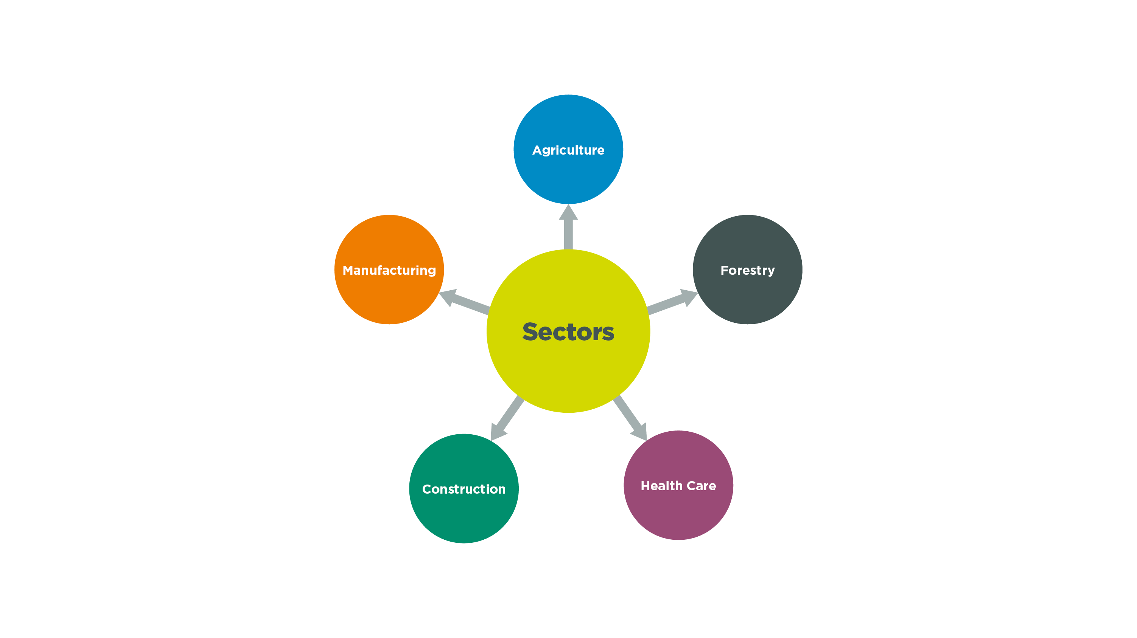

Slide 6
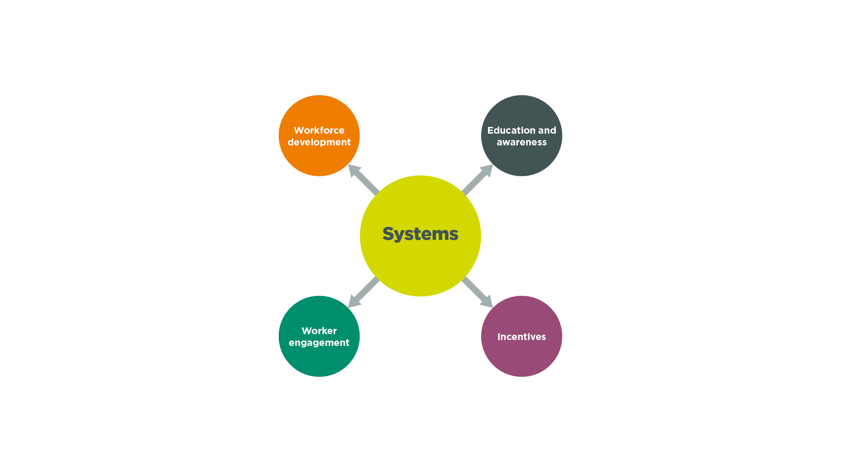

Slide 9
EVERY YEAR*...
MANY MORE UNREPORTED CASES
30,000 NEW CASES OF SERIOUS ILL-HEALTH
600 TO 900 DEATHS
*estimated figures

Slide 10
A TYPICAL WORKER IS
10 TIMES
MORE LIKELY TO DIE FROM
WORK-RELATED ILL-HEALTH THAN A WORKPLACE SAFETY INCIDENT

Slide 11
SUPPORTING WORKER HEALTH AND WELLBEING
VOLUNTARY
Resilience, engagement
WELLBEING
Promotion of resilience and wellbeing
WORKSAFE MAY ENCOURAGE
Managing obesity, encouraging physical activity
HEALTH PROMOTION
Activities to reduce risk of lifestyle disease
MANDATORY
WORKSAFE WILL ENGAGE, EDUCATE AND ENFORCE
Noise, work-related stress, fatigue
HEALTH AND SAFETY PROTECTION
Preventing work-related harm to health and safety

Slide 12
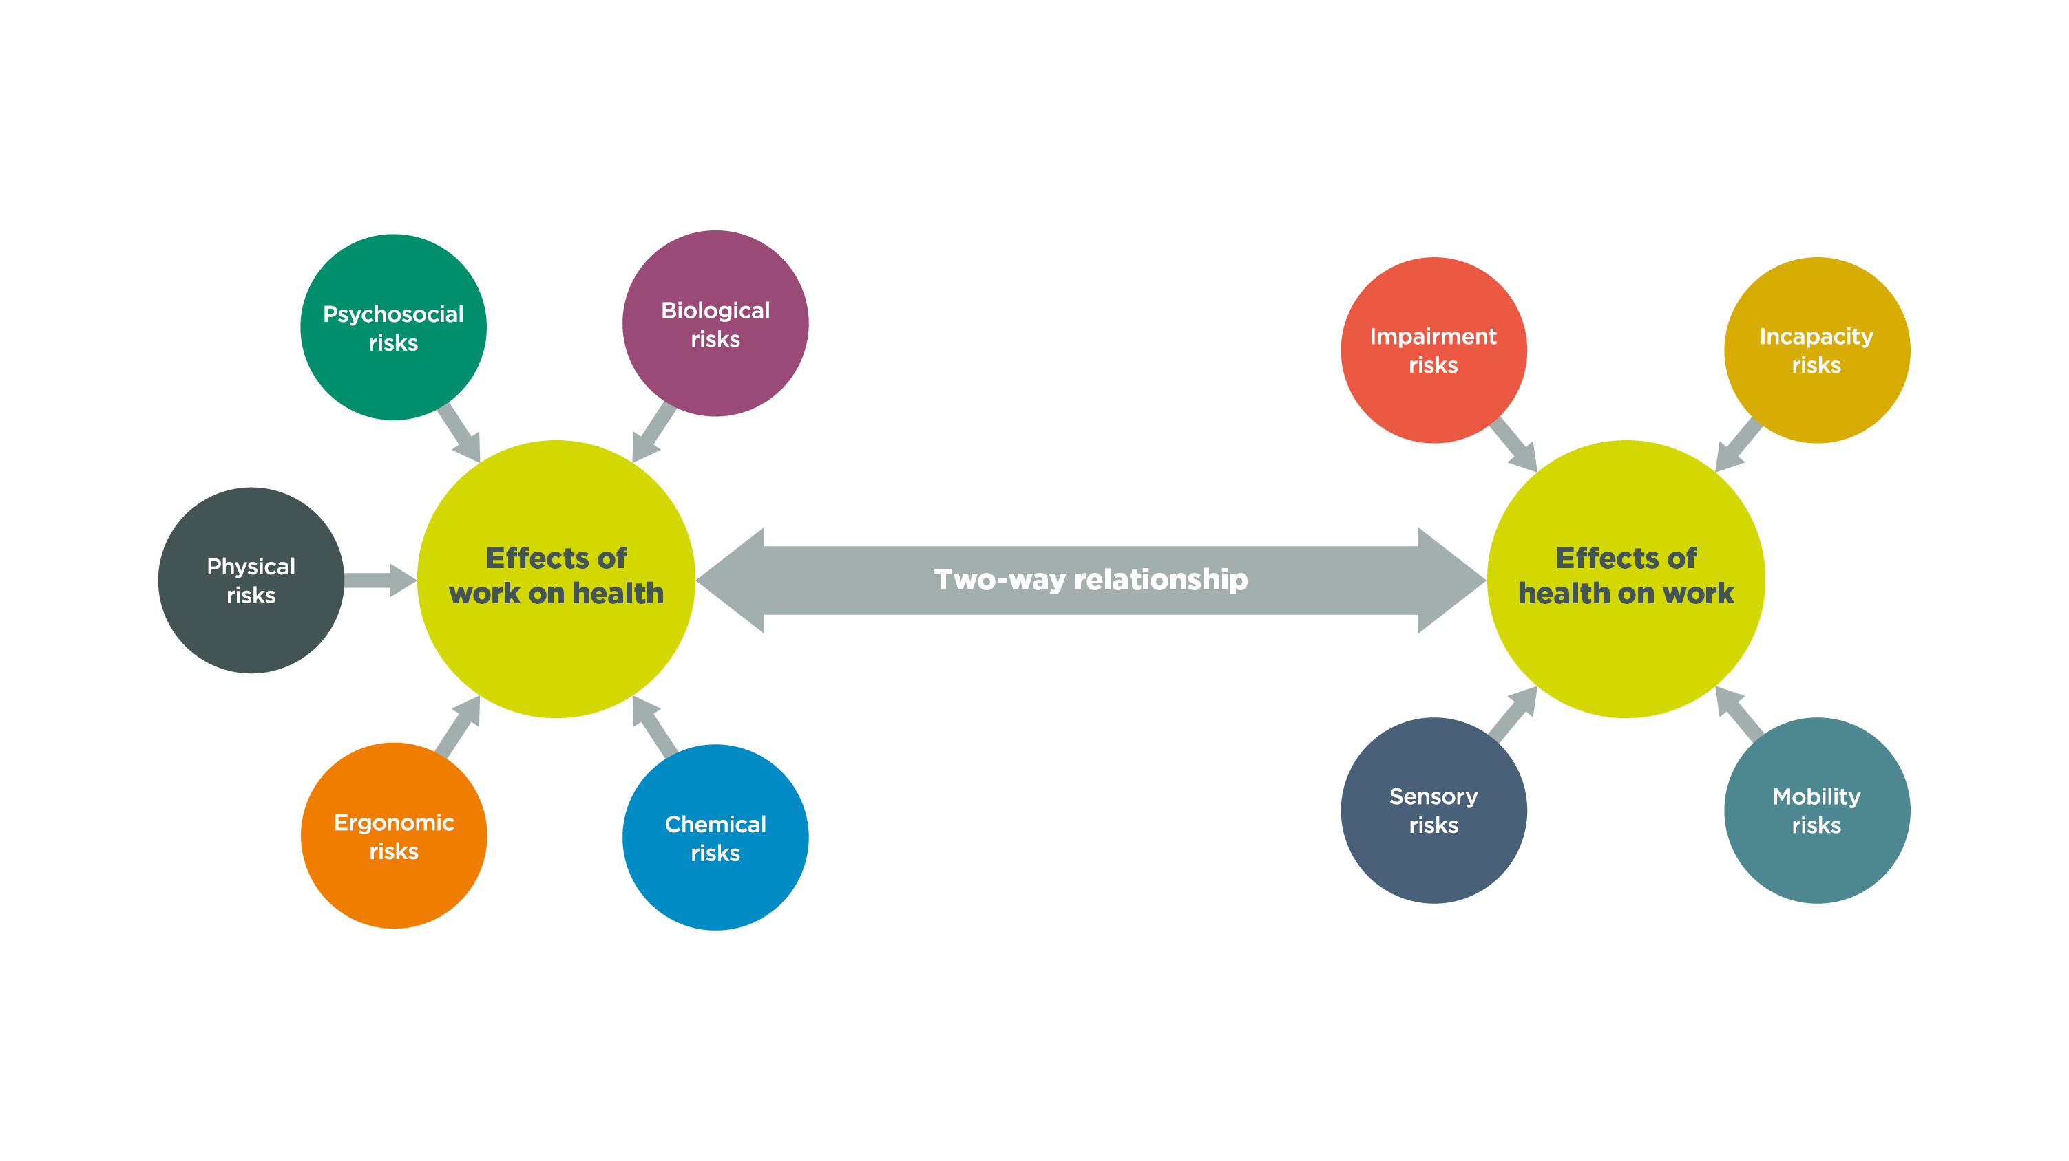
WHAT IS WORK-RELATED HEALTH?

Slide 13
WORK-RELATED HEALTH STRATEGIC APPROACH
VISION AND OUTCOMES
Vision
“EVERYONE WHO GOES TO WORK COMES HOME HEALTHY AND SAFE”
system targets
Fewer people experience work-related ill-health
substantive impacts
Work-related health risks managed better. exposures to health hazards are reduced
Immediate impacts
Awareness, attitudes and behaviours related to work-related health improve
STRATEGIC PLAN
THEME 1: INDUSTRY LEADERSHIP
THEME 2: REGULATORY EFFECTIVENESS
THEME 3: STEP CHANGE
Work-related health strategic themes

Slide 14
ACHIEVING THE VISION
THEME 1
INDUSTRY LEADERSHIP
THEME 2 REGULATORY EFFECTIVENESS
THEME 3
STEP CHANGE
1
Awareness, participation and learning
5
Organisational capability
9
Targeted programmes
2
Partnering with others
6
Guidance and education
3
Health by design
7
Research and intelligence
4
Workforce development
8
Regulatory framework

Slide 15
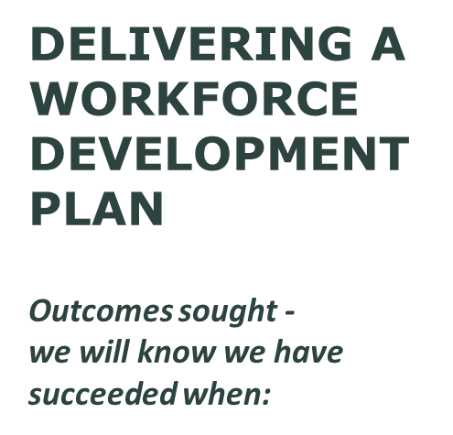

Slide 16
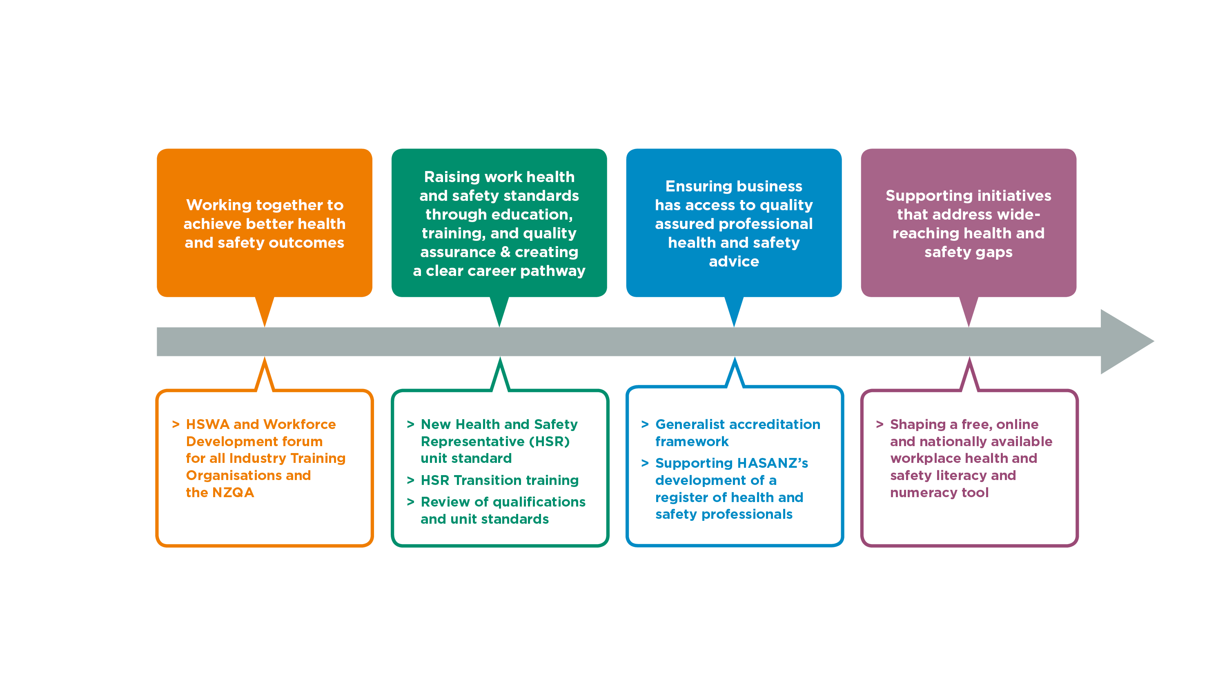

Slide 17
proportionate, consistent regulatory practice
Practice framework sets standards and expectations of how we want our inspectors, and others, to work:
specifies what is mandatory because of legislation, operational policy or to mitigate organisational risk
specifies scope of inspectors discretion

Slide 18
proportionate, consistent enforcement
Enforcement decision-making model guides discretion of inspectors
Takes inspectors through a process so they can make an enforcement decision
Can be applied in almost any situation or set of circumstances
Guides training, peer review and management oversight
Ensures proportionate, consistent and transparent action
Based on the UK Health and Safety Executive Enforcement model.
Available on our website

Slide 19
How are we performing?
Annual service excellence survey
Inspectors “fair educators”
73% respondents say satisfied or very satisfied with
Inspector interaction (56% previous year)
72% report better understanding of responsibilities (61% previous year)
75% made at least one change to practices after contact with WorkSafe

Slide 20
The Hazardous substances landscape
Operations & Support Group
MHF Team
Work-related Health
[HSWA, GRWM Regulations, WES etc.]
PRESCRIPTIVE
REGULATORY CONTROLS [HSNO Act, Regulations etc.]
PROCESS SAFETY
[HSNO Act, HSWA MHF Regulations]
Hierarchy of Controls (LEV, PPE/RPE etc.), Health/Exposure Monitoring
Foundation Controls
SDS’, Inventory, PPE/RPE, Training & Supervision etc.
Asset Integrity
Preventative Maintenance
Higher-risk Controls
Test Certifier Regime, Tracking, CSL, Secondary Containment, Tank Wagons, Compressed Gasses, Stationary Container System, Signage, Emergency Response etc.
Clean Air Project
Timber Treatment Project
MHF registration and audit of facilities
Agrichemicals Project
Waste Oil Project
Notes:
The hazardous substances landscape is broad and complex, spanning from general requirements to protect the health and safety of those using substances in the workplace, to ensuring specific controls are in place for particular types and quantities of substance, right through to the major hazard facility regime which exists to prevent catastrophic harm.
The Operations & Support group operates across that range, including:
Assessment of work related health controls for those using substances in a work place (eg local exhaust ventilation, respiratory protection)
Assessment of prescriptive HSNO controls that must be in place when chemicals are being used (eg safety data sheets, training & supervision) through to more complex controls when large quantities or more hazardous substances are being used
Consideration of process safety for more complex sites for facilities with the potential to cause a high consequence event where a loss of containment occurs
Management and quality assurance of the of the test certifier network, who provide third party certification of sites where many higher risk controls are required
Responding to incidents that occur in the workplace, including working with the Major Hazard Facilities team to provide support with investigations.

Slide 21
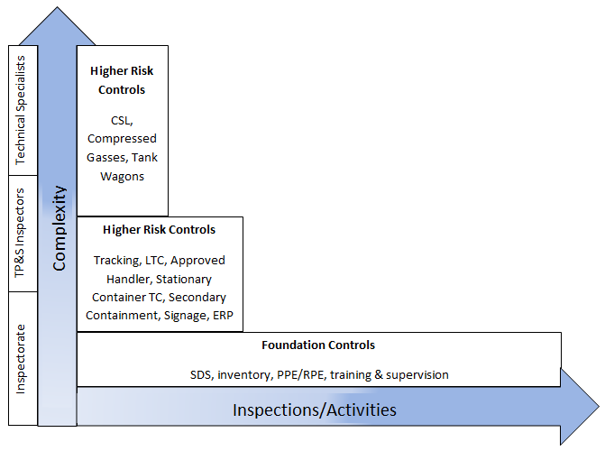
Required capability
Core L&D Programme for L1 and L2
Project-roll-out for L3
Ongoing inspectorate development supported by Technical Programmes & Support
L3
L2
L1
Notes:
In order to carry out this work our teams must have the right skills for their work and to work together to ensure the risks posed by hazardous substances are managed.
For inspectors, this means that when hazardous substances are identified in a workplace then inspectors will be expected to assess the Foundation Controls as part of a level 1 B.A.U. risk assessment.
Where the risk is such that additional Higher Risk Controls are required then the inspectorate, supported by the six inspectors seconded to TP&S will use tools such as the HSNO Calculator to assess the risk as part of a level 2 assessment.
The Operations & Support Group is working with the Learning & Development team to ensure the Level 1 warranting programme and Level 2 inspector training programme deliver the critical skills needed by the inspectorate to carry out this work and with Chief Inspectors and managers to set expectations.
Where more complex projects are delivered that assess additional controls, or potentially blend into other areas such as health assessment, then additional training over and above the core L&D programme will be rolled out as part of the project. The Clean Air project is an example of this model.
We are exploring additional structures, similar to the Champions Network, that will continue to support the ongoing development of inspector capability to respond to unplanned events and to take part in more complex work.

Slide 23
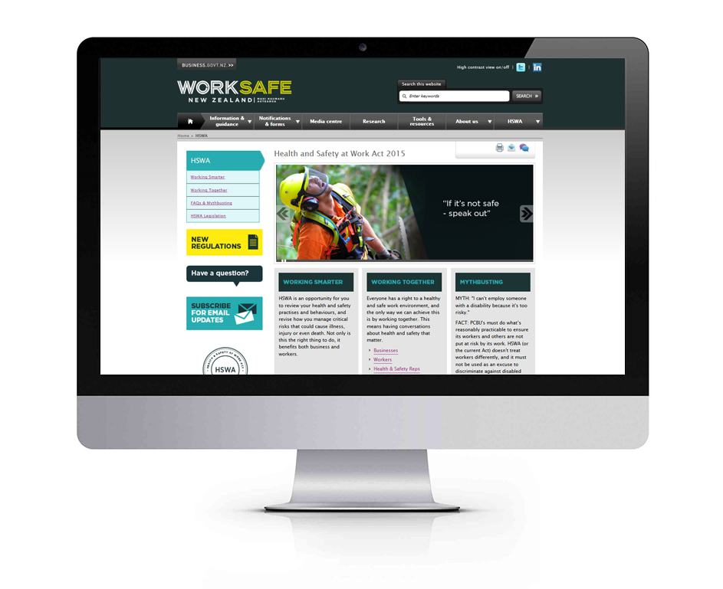
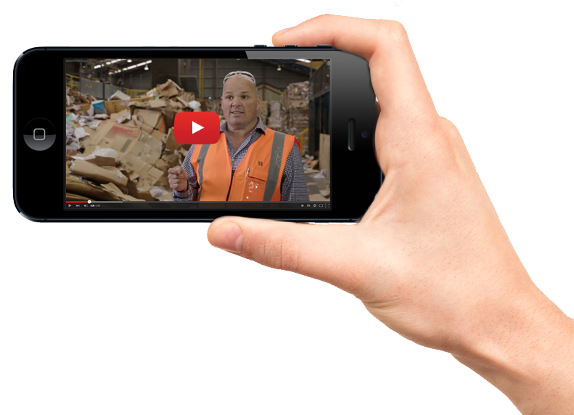
Communication and information tools

Slide 24
For more information visit: worksafe.govt.nz
facebook.com/nzworksafe
linkedin.com/company/worksafe-new-zealand
twitter.com/WorkSafeNZ

