Slide 1

Welcome to ‘InfoFest’ 2016
Your Workplace Safety Update
What? When? How?

Slide 2

Keeping Safe at Work

Slide 3

Purpose
To help ensure you are aware of how new workplace health and safety legislation can impact your business

Slide 4
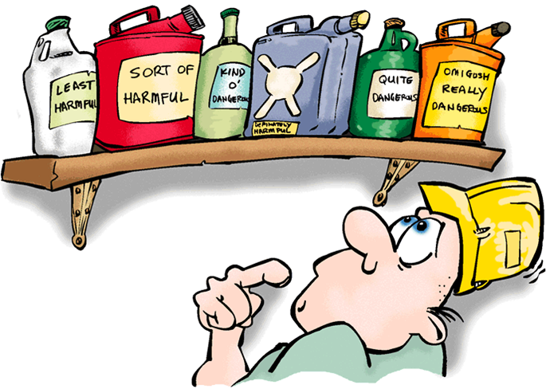
Particularly safely managing
the chemicals present in every workplace

Slide 5

Particularly SMEs

Slide 7
Government Policy:
  Less Government involvement.
  Greater self-sufficiency.
  Less regulation.
  Reduce cost of doing business
  Skilled workforce.

Slide 8
Risk Averse Environment

Slide 9

Each year:
100-120 Acts.
350 Regulatory instruments.

Slide 10
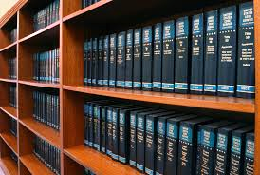
Complexity
+
Imprecision

Slide 11


Slide 12
Our Panel
Gordon MacDonald WorkSafe NZ
Kim Comben MoBIE
Wayne Vernon MHF

Slide 13

Thank you for your commitment to safely managing your workplace chemicals

Slide 14


