Slide 1

Welcome to the
Responsible Care NZ
AGM FY 2015-16
Agenda:
Chairman’s remarks.
Previous Minutes.
CEO’s Report
Board Members.
Finance.
General business.

Slide 2
CEO’s Report FY 2015-16
Operational environment.
Global: - UNEP Sustainability.
- Takeovers/mergers.
Domestic: - HSW Act.
                - NZ Fire Service review
Keeping SMEs compliant.

Slide 3
Responsible Care® Global Charter:
  “Social contract to operate”
  Sound science.
  Transparency.
  Product stewardship.
  Capacity building.

Slide 4

Responsible Care®
Global Charter

Slide 5
Local Chemical Issues
Integration with HSW Act.
Updating Hazardous Substances Regulations Phase I and II.
Improve compliance.
NZ Fire Service Review (FENZ).

Slide 6

Keeping Safe at Work

Slide 7
Government Policy:
  Less Government involvement.
  Greater self-sufficiency.
  Less regulation.
  Reduce cost of doing business
  Skilled workforce.

Slide 8
Risk Averse Environment

Slide 9

Each year:
100-120 Acts.
350 Regulatory instruments.

Slide 10
To date:
2,912 Acts.
5,210 legislative instruments.
10-14,000 bureaucrats.

Slide 11

Complexity
+
Imprecision

Slide 12

We will always be needed
We will always be needed

Slide 13
Why we are invaluable:
Compliance advice.
Specialist training.
Compliant SDS.
Site compliance assessments.

Slide 14
Key Relationships
WorkSafe NZ.
Major Hazard Facility (MHF).
MFE and RMA Hazardous Waste team.
EPA.
HSNO Test Certifiers.

Slide 15
Issues
Hazardous Substances Regulations.
Mandatory Approved Handlers.
Rescue of Test Certification system.
Support Workplace Inspectors.

Slide 16
RCNZ Strategy
Help develop and implement HSW Act and Hazardous Substances Regulations.
Expand outreach to chemical users.
Consolidate and embrace partnerships.

Slide 17
Our Industry Contribution
  Advice - Compliance-SDS-Labels
  Education - -Workshops
                -Posters
                -National performance standards
  Training - -Chemicals safety, Asbestos
  ‘Walk and Talk’ Site assessments
  Encourage Product Stewardship

Slide 18
Key Performance Indicators
Members to April 2016 = 7 + 1 Partner
Training:
Approved Handler 150
HSNO Advanced 50
Site assessments 5

Slide 19
FY 2015-16 Financial Report
Turnover | $777,528.00 vs $803,620.00
Deficit | $33,571.00 vs $16,914.00
Reserve | 18 months operations

Slide 20
RCNZ Board
Chairman | Tom Barratt | Evonik Degussa
Director | Warren Banks | Saffron Consulting
Director | John Morgan | NIWA
Director | Murray Nancekivell | Chemcolour
Director | Andrew Syme | Dow AgroSciences
Director Nomination | Shayne Porter | Mainfreight

Slide 21
Endorse
Directors.
Nominee: Shayne Porter.
Accounts 2015/16.
Accountant.

Slide 22
General Business

Slide 23
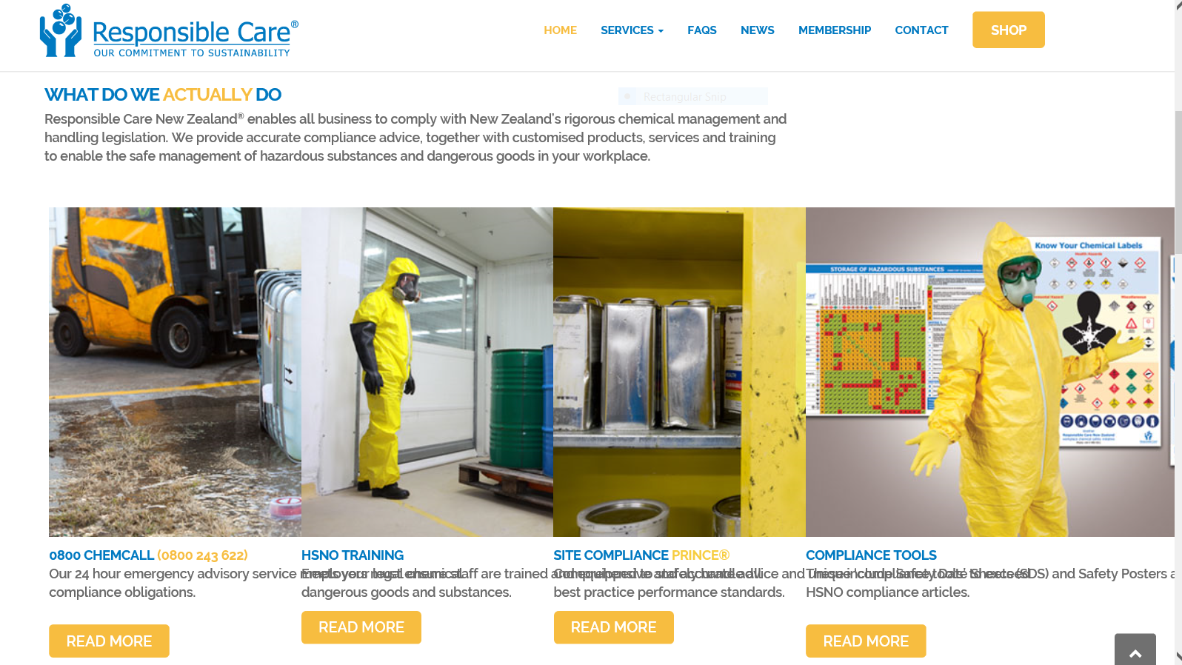
Preview: http://www.cmcdeploy.co.nz/responscare/

Slide 24


Thanks for your interest

